Slide 2
Brain Computer Interfacing: Steady State Visually Evoked Potential
Group 31• 25.03.18
Prashanth H C
Pavan Kumar D
Sawan Singh Mahara
Lakshmiraj
Mrs. Vidya T V
Assistant Professor, PESIT-BSC

Slide 3
Brief Overview

Slide 4
Recap
What is SSVEP?
What are we doing with SSVEP?
Covariance Matrices
Clusters
Algorithm 1
Cluster covariance matrices in ‘some space’
Find the centroid of these clusters
Algorithm 2
Compute ‘distances’ between matrix centers and an EEG epoch to be classified
The center that gives the least distance is the class which the epoch is classified as belonging to

Slide 5
Progress
Accomplishments
Outlier removal from EEG epochs training set.
Filtering of EEG Signals

Slide 6
Outlier Removal

Slide 7
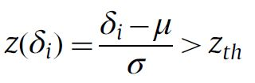
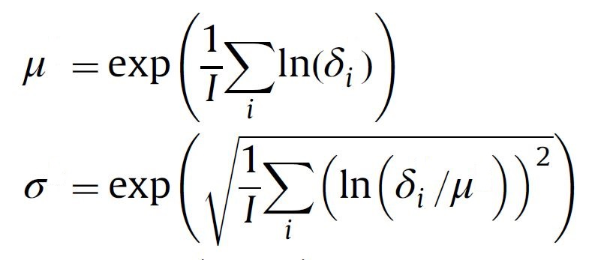
Outlier Removal
Riemannian potato approach is used.
A reference covariance matrix is estimated, by using a distance metric between trials adaptively.
Any trial that lies too far, i.e. beyond a certain threshold, from the reference matrix in terms of the distance metric used is rejected.
Z-score thresholding is done as:
Where

Slide 8


Outlier Removal
The reference point could be estimated in an adaptive manner during the whole recording session according to the following equation:
The threshold ‘th’ is estimated based on the mean μ and standard deviation of the distance to the reference matrix defined :
Through cross-validation, though, the z-score threshold is set to z’th’ = 2.2
Because of good sensitivity of Riemannian metric, the artefacts lie several standard deviations away from the reference.

Slide 9
Algorithmic Briefing

Slide 10
Algorithm 3
Issues with using Algorithm 1 and 2 only.
Cues for the onset and offset of EEG epochs must be provided.
EEG Epoch size is not well defined and is seemingly arbitrary
Thus no optimum can be quantified

Slide 11
Algorithm 3
Outline
Make epoch size variable
Predict class repeatedly
Check how frequently the predictor classifies one class
Define a threshold (even empirically will do)
Compare frequency of class prediction with the threshold
Predict a class only if this confidence is above the threshold.
Robustness
Outline appears to be only expanding dataset for algorithm 1 and algorithm 2
Is adding a threshold enough?
Have to increase robustness
Done by considering trajectories of covariance matrices in epochs.

Slide 12
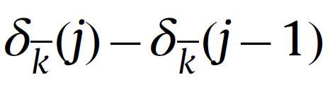
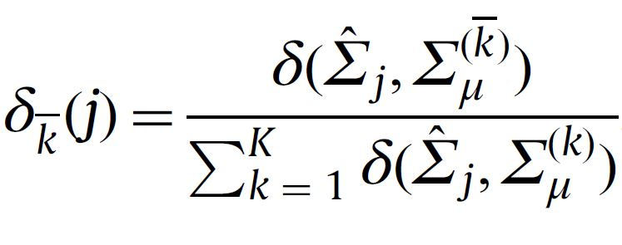
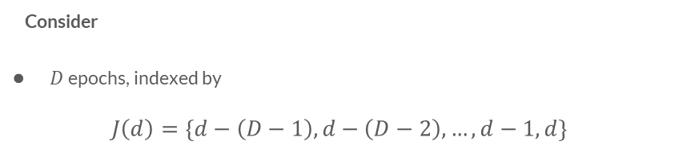
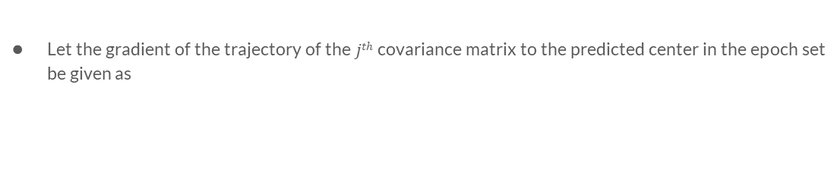
Algorithm 3
Consider
$D$epochs, indexed by
$$J\left(d\right)=\left\{d−\left(D−1\right), d−\left(D−2\right),…,d−1,d\right\}$$
Let the gradient of the trajectory of the $jth$ covariance matrix to the predicted center in the epoch set be given as
Where

Slide 13
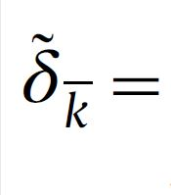
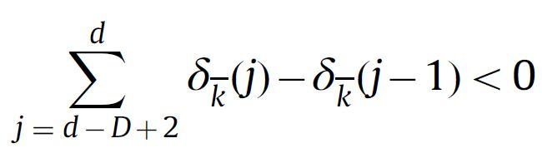

Algorithm 3
The trajectory of the epochs must be towards the center
The sum of all the $D$epochs’ gradients must be negative.
Accuracies can be improved with this condition
Cue onset and offset is not required.

Slide 14
LED Array

Slide 15
Led Array (The 555 timer)
555 timer IC in an Astable mode to produce a very stable 555 Oscillator circuit .
Whose output frequency can be adjusted by means of an externally connected RC tank circuit.

Slide 16

50% Duty Cycle Frequency Equation
$Ton=0.693 \left(R1+Rv\right)C$
$Toff=0.693 \left(R2+Rv\right)C$
$T=Ton+Toff$
$f=\frac{1}{0.693\left(2R_{2}\right)C}$

Slide 17
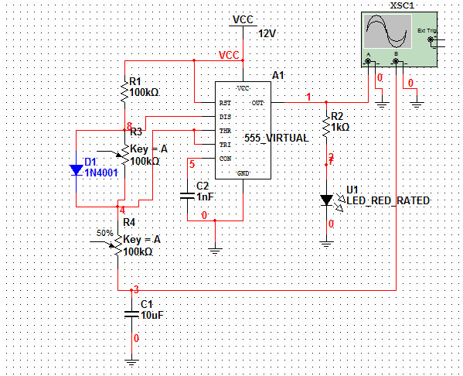
Circuit

Slide 18
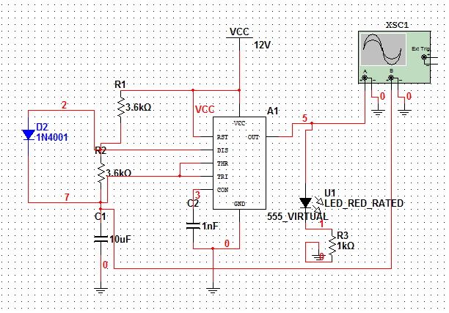
Old Circuit

Slide 19
Next steps
Assignment 1: LED array module
Assignment 2: Recording of own EEG dataset
Assignment 3: Classification using curve based method

Slide 20
Thank You

